Slide 1
STATISTICS
CO4- Inferential Statistical Analysis

Slide 2
STATISTICS
﻿
Statistics is the science which deals with the methods of collecting, classifying, presenting, comparing and interpreting numerical data collected to throw some light on any sphere of enquiry.
- Seligman
By statistics we mean aggregates of facts affected to a marked extent by multiplicity of causes numerically expressed, enumerated or estimated according to reasonable standards of accuracy, collected in a systematic manner for pre determined purpose and placed in relation to each other.
- Horace Secrist

Slide 3
DISSECTION OF DEFINITION
STATISTICS
aggregates of facts
affected to a marked extent by multiplicity of causes
numerically expressed, enumerated or estimated
according to reasonable standards of accuracy
collected in a systematic manner
manner for pre determined purpose
placed in relation to each other.

Slide 4
Two branches of statistics
STATISTICS
MATHEMATICAL
STATISTICS
APPLIED
STATISTICS
Applications of tools and techniques on real life data
Encompasses theories, theorems, derivations

Slide 5
TYPES OF STATISTICAL METHODS
STATISTICAL
METHODS
DESCRIPTIVE
Diagnostic
PREDICTIVE
PRESCRIPTIVE
WHAT COULD HAPPEN?
WHAT SHOULD WE DO?
WHAT HAS HAPPENED?
WHY IT HAS HAPPENED?

Slide 6
IMPORTANCE OF STATISTICS
Statistics is the way of thinking that can help enhance your effectiveness in business.
Applying statistics correctly is a fundamental, global skill in your business education.

Slide 7


Slide 8
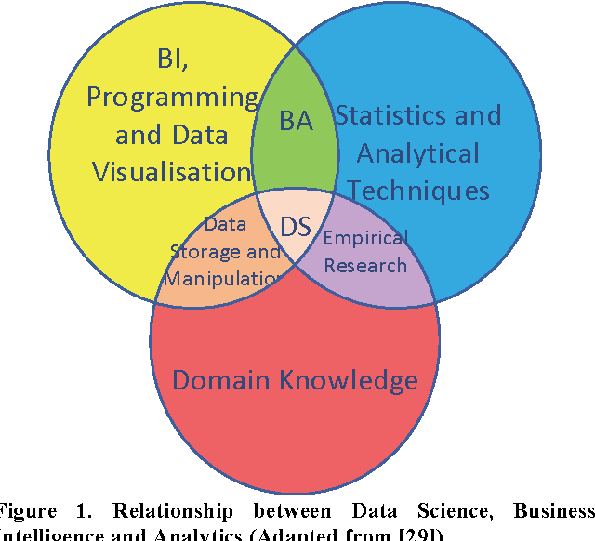

Statistics in current scenario

Slide 9
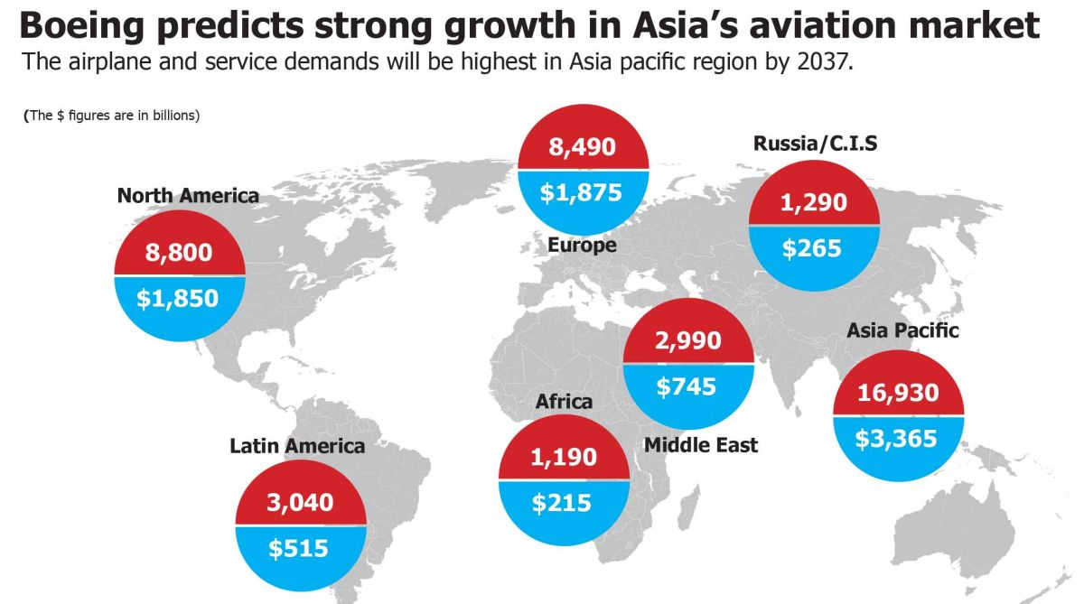
Example

Slide 10
Datum - Data - Information
Data
Quantitative
Qualitative
Process
Statistics
Mathematics
Information
Knowledge
Wisdom

Slide 11
Measure of Central Tendency

Slide 12
Measure of central tendency
Otherwise called as:
Measure of central tendency :All the observations in the data, will tend towards the mean value(Central value)
Arithmetic mean (Simple and Weighted), Median, Mode, Geometric Mean, Harmonic Mean
Measures of Dispersion :
Averages

Slide 13
Measures of Dispersion
To understand the pattern of the data , its spread and variability.
Additional information that enables to judge the reliability of Measure of Central Tendency.
To understand the dispersion of data to make appropriate analysis and interpretation
Compare the dispersion of various samples and avoid choosing widely dispersed samples.

Slide 14
Range
Range = Value of the highest observation - Value of the lowest observation
Otherwise,
Range = Maximum value – Minimum Value

Slide 15
Inferential Statistical Analysis

Slide 16
Statistical inference defined
We’ll define statistical inference as the process of generating conclusions about a population from a noisy sample. Without statistical inference we’re simply living within our data. With statistical inference, we’re trying to generate new knowledge.

Slide 17
Motivating example: who’s going to win the election?
In every major election, pollsters would like to know, ahead of the actual election, who’s going to win. Here, the target of estimation (the estimand) is clear, the percentage of people in a particular group (city, state, county, country or other electoral grouping) who will vote for each candidate. We can not poll everyone. Even if we could, some polled may change their vote by the time the election occurs. How do we collect a reasonable subset of data and quantify the uncertainty in the process to produce a good guess at who will win?

Slide 18
Motivating example, predicting the weather
When a weatherman tells you the probability that it will rain tomorrow is 70%, they’re trying to use historical data to predict tomorrow’s weather - and to actually attach a probability to it. That probability refers to population.

Slide 19
Motivating example, brain activation
An example that’s very close to the research I do is trying to predict what areas of the brain activate when a person is put in the fMRI scanner. In that case, people are doing a task while in the scanner. For example, they might be tapping their finger. We’d like to compare when they are tapping their finger to when they are not tapping their finger and try to figure out what areas of the brain are associated with the finger tapping.

Slide 20
The goals of inference
You should recognize the goals of inference. Here we list five examples of inferential goals.
1. Estimate and quantify the uncertainty of an estimate of a population quantity (the proportion of people who will vote for a candidate).
2. Determine whether a population quantity is a benchmark value (“is the treatment effective?”).
3. Infer a mechanistic relationship when quantities are measured with noise (“What is the slope for Hooke’s law?”)
4. Determine the impact of a policy? (“If we reduce pollution levels, will asthma rates decline?”)
5. Talk about the probability that something occurs.

Slide 21
The tools of the trade
Several tools are key to the use of statistical inference. We’ll only be able to cover a few in this class, but you should recognize them anyway.
1. Randomization: concerned with balancing unobserved variables that may confound inferences of interest.
2. Random sampling: concerned with obtaining data that is representative of the population of interest.
3. Sampling models: concerned with creating a model for the sampling process, the most common is so called “iid”.
4. Hypothesis testing: concerned with decision making in the presence of uncertainty.
5. Confidence intervals: concerned with quantifying uncertainty in estimation.
6. Probability models: a formal connection between the data and a population of interest. Often probability models are assumed or are approximated.
7. Study design: the process of designing an experiment to minimize biases and variability.
8. Nonparametric bootstrapping: the process of using the data to, with minimal probability model assumptions, create inferences.
9. Permutation, randomization and exchangeability testing: the process of using data permutations to perform inferences.

Slide 22
Different thinking about probability leads to different styles of inference
We won’t spend too much time talking about this, but there are several different styles of inference. Two broad categories that get discussed a lot are:
1. Frequency probability: is the long run proportion of times an event occurs in independent, identically distributed repetitions.
2. Frequency style inference: uses frequency interpretations of probabilities to control error rates. Answers questions like “What should I decide given my data controlling the long run proportion of mistakes I make at a tolerable level.”
3. Bayesian probability: is the probability calculus of beliefs, given that beliefs follow certain rules.
4. Bayesian style inference: the use of Bayesian probability representation of beliefs to perform inference. Answers questions like “Given my subjective beliefs and the objective information from the data, what should I believe now?”

Slide 23
In this class, we will primarily focus on basic sampling models, basic probability models and frequency style analyses to create standard inferences. This is the most popular style of inference by far.
Being data scientists, we will also consider some inferential strategies that rely heavily on the observed data, such as permutation testing and bootstrapping.
As probability modeling will be our starting point, we first build up basic probability as our first task.

Slide 24
Inferential statistics
Inferential statistics provide a way of: going from a “sample” to a “population” inferring the “parameters” of a population from data on the “statistics” of a sample. i.e., parameters such as m and s, from statistics such as m and s. But before we can see what is involved in the move from sample to population we need to understand how to move from population to sample. The study of obtaining a sample from a population is “probability.”

Slide 25
Tangible benefits of Bayesian inference
Simple and intuitive model building (unlike frequentist statistics there is no need to remember lots of specific formulae). Exhaustive and creative model testing. The best predictions;
for example, Nate Silver. Allows estimation of models that would be impossible in frequentist statistics. Dealing with “beliefs” that can be updated rather than fixed “long-run frequencies” means Bayesian statistics has wider applications; for example, robot vision and navigation.

Slide 26
Why don’t more people use Bayesian inference?
Most existing texts put a strong emphasis on its (seemingly) complex mathematical basis. Poor explanation of why we need MCMC algorithms. Poor explanation of how these MCMC algorithms work, and how to implement them in practice. The view that Bayesian inference is more wishy-washy than frequentist inference.

Slide 27
Statistical Inference: the use of sample data to make judgments or decisions about populations.
The two most common statistical inference procedures are confidence interval estimation and hypothesis testing.
• Confidence Interval Estimation: A confidence interval is a range of values that the researcher is fairly confident will cover the true, unknown value of the population parameter. In other words, we use a confidence interval to estimate the value of a population parameter. We have already encountered the idea of a margin of error and using it to form a confidence interval for a population proportion.
• Hypothesis Testing: Hypothesis testing uses sample data to attempt to reject a hypothesis about the population. Hypothesis testing is applied to population parameters by specifying a null value for the parameter—a value that would indicate that nothing of interest is happening.
Hypothesis testing proceeds by obtaining a sample, computing a sample statistic, and assessing how unlikely the sample statistic would be if the null parameter value were correct. In most cases, the researchers are trying to show that the null value is not correct. Achieving statistical significance is equivalent to rejecting the idea that the observed results are plausible if the null value is correct.

Slide 28
Normal Approximation to the Binomial Distribution
If X is a binomial random variable based on n trials with success probability p, and n is large, then the random variable X is also approximately N(np, np(1− p)). Conditions: The approximation works well when both np and n(1 – p) are at least 10.

Slide 29
Estimating Proportions with Confidence
Big Idea of Confidence Intervals: Use sample data to estimate a population parameter. Recall some of the language and notation associated with the estimation process. • Population and Population Parameter • Sample and Sample Statistic (sample estimate or point estimate) The sample estimate provides our best guess as to what is the value of the population parameter, but it is not 100% accurate. The value of the sample estimate will vary from one sample to the next. The values often vary around the population parameter and the standard deviation give an idea about how far the sample estimates tend to be from the true population proportion on average. The standard error of the sample estimate provides an idea of how far away it would tend to vary from the parameter value (on average). The general format for a confidence interval estimate is given by: Sample estimate ± (a few) standard errors

Slide 30
The “few” or number of standard errors we go out each way from the sample estimate will depend on how confident we want to be. The “how confident” we want to be is referred to as the confidence level. This level reflects how confident we are in the procedure. Most of the intervals that are made will contain the truth about the population, but occasionally an interval will be produced that does not contain the true parameter value. Each interval either contains the population parameter or it doesn’t. The confidence level is the percentage of the time we expect the procedure to produce an interval that does contain the population parameter.

Slide 31
Confidence Interval for a Population Proportion p
Goal: we want to learn about a population proportion . How? We take a random sample from the population and estimate p with the resulting sample proportion . Let’s first recall how those many possible values for the sample proportion would vary, that is, the sampling distribution of the statistic . pˆ pˆ p

Slide 32
Using Confidence Intervals to Guide Decisions
Think about it: A value that is not in a confidence interval can be rejected as a likely value of the population proportion. A value that is in a confidence interval is an “acceptable” possibility for the value of a population proportion.

Slide 33
Estimating Proportions with Confidence
Confidence interval example from Fri lecture Gallup poll of n = 1018 adults found 39% believe in evolution. So = .39 A 95% confidence interval or interval estimate for the proportion (or percent) of all adults who believe in evolution is .36 to .42 (or 36% to 42%). Confidence interval: an interval of estimates that is likely to capture the population value. Goal today: Learn to calculate and interpret confidence intervals for p and for p1 − p2 and learn general format

Slide 34
Remember population versus sample:
Population proportion: the fraction of the population that has a certain trait/characteristic or the probability of success in a binomial experiment – denoted by p. The value of the parameter p is not known.
Sample proportion: the fraction of the sample that has a certain trait/characteristic – denoted by . The statistic is an estimate of p. The Fundamental Rule for Using Data for Inference: Available data can be used to make inferences about a much larger group if the data can be considered to be representative with regard to the question(s) of interest.

Slide 35
Some Definitions:
• Point estimate: A single number used to estimate a population parameter. For our five situations: point estimate = sample statistic = sample estimate = for one proportion = for difference in two proportions
• Interval estimate: An interval of values used to estimate a population parameter. Also called a confidence interval. For our five situations, always: pˆ 1 2 pˆ − pˆ Sample estimate ± multiplier × standard error

Slide 36
Inferential Statistics
Parameter vs. Statistic
! A population is the entire set of individuals that we are interested in studying ! A sample is simply a subset of individuals selected from the population ! In most studies, we wish to quantify some characteristic of the population ! parameter ! Parameters are generally unknown, and must be estimated from a sample ! The sample estimate is called a statistic

Slide 37
Inferential Statistics
Techniques that allow us to make inferences about a population based on data that we gather from a sample ! Study results will vary from sample to sample strictly due to random chance (i.e., sampling error) ! Inferential statistics allow us to determine how likely it is to obtain a set of results from a single sample ! This is also known as testing for “statistical significance”

Slide 38
Statistical Significance
Consider a small weight loss study of 40 patients. ! After such a study is over, we want to make generalizations about a larger group (e.g. all similar patients in the nation), but, since it is a small study, the results will be inexact. ! Statistical significance helps us by giving us a "ballpark range" (i.e., confidence interval) around the number (for example the amount of weight lost), encompassing the true number

Slide 39
Statistical Significance (contʼd)
If the range is small enough (p < .05), we say we are confident that the true amount of weight lost is "more than zero" and "statistically significant.” ! Naturally, it says nothing about the practical significance, since the patients might have lost just a gram of weight!

Slide 40
Summary notes:
These examples illustrate many of the difficulties of trying to use data to create general conclusions about a population. Paramount among our concerns are:
Is the sample representative of the population that we’d like to draw inferences about?
Are there known and observed, known and unobserved or unknown and unobserved variables that contaminate our conclusions?
Is there systematic bias created by missing data or the design or conduct of the study?
What randomness exists in the data and how do we use or adjust for it? Here randomness can either be explicit via randomization or random sampling, or implicit as the aggregation of many complex unknown processes.
Are we trying to estimate an underlying mechanistic model of phenomena under study?
Statistical inference requires navigating the set of assumptions and tools and subsequently thinking about how to draw conclusions from data.

